Slide 1

Cognitieve Oplossingen
Named-entity recognition (NER)
17 december 2018
Roel van der Burg

Slide 2
NER-Tagging
What to tag?
Names(PERS)
Institutes/Organisations (ORGS)
Locations (LOC)
Data: Set of (7156, 11270) 12494 letters of objection
Gold set annotating:
Manually
Semi-supervised

Slide 3
First approach
Create a gold set with regular expressions:
Get a list of potential names from the text with regexp
Perform fuzzy-string matching with the text
Threshold the matches

Slide 4




Matching with RegExp
False positives
Partial matches
Readability RE’s
Examples :
E.E._ de Vries
R VAN ERP-VAN DER VALK
C.C' Visser - den Boer

Slide 5
Solution: Match with N-grams
Matchen met n-grams:
Dit is de aangifte van]....[/. "% (Z,—äì/ .meneer R'L'] van der Burg en hiermee wil ik aangeven.
Hierbij maken ..;’// c..’;%t, J_J_ van der Jan- Jansen Bezwaar tegen ..
Tokenize op whitespace:
[‘Dit’, ‘is’, ‘de’, ‘aangifte’, ‘van]....[/.’, ‘"%’, ‘(Z,—äì/’, ‘.meneer’, ‘R'L']’, ‘van’, ‘der’, ‘Burg’, ‘en’, ‘hiermee’, ‘wil’, ‘ik’, ‘aangeven.’]
Neem 4-grams:
('%', '(Z,—äì/', '.meneer', "R'L']"), ('(Z,—äì/', '.meneer', "R'L']", 'van'), ('.meneer', "R'L']", 'van', 'der'),
("R'L'], 'van', 'der', 'Burg'), ('van', 'der', 'Burg', 'en')
('..;’//', 'c..’;%t,', ‘J_J_', 'van', 'der'), ('c..’;%t,', ‘J_J_', 'van', 'der', ‘Jan-'), (‘J_J_', 'van', 'der', Jan-', ‘Jansen'), ('van', 'der', Jan-', ‘Jansen', ‘Bezwaar'),

Slide 6
Hangup
Average length tokenized text ≈ 479 tokens.
Taking n-grams from 1 to 7: (479 + 478 + 477 + 476 + 475 + 474 + 473) = 3332 potential pairs
To be checked against ≈ 10 name permutations from the database
Fuzzy matching = computationally expensive

Slide 7
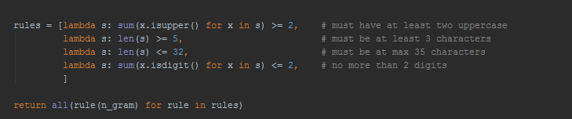
Efficiency
Leaving out n-grams without potential:
Time: ≈ 399 s / 10.041 documents

Slide 8
Fuzzy matching
Closest name in database
Fuzzy-Match score
Positition of gram
---- n gram 1 ---- Potentiële matches: [(0, 4, 'EIOB'), [(‘JANN', 25] [(526, 532, ‘J.J.J.'), [(‘J J J', 100)] Score drempel: [(526, 532, ‘J.J.J.'), [(‘J J J', 100)]
---- n gram 2 ---- Potentiële matches: [(0, 21, 'EIOB 2AAlsda'), [(‘J J J VAN DER JANSEN', 15)], [(69, 72, 'T L'), [('VOET', 29)] Score drempel: [(526, 532, ‘J.J.J.'), [(‘J J J', 100)]]
---- n gram 4 ---- Potentiële matches: [(64, 72, '…… 7 T L'), [(‘J J J', 40) Score drempel: [(526, 546, ‘J.J.J. van der Jansen,'), [(J J J VAN DER JANSEN ', 97)]
Impliciete matches verwijderen
[(526, 532, ' J.J.J.'), [(‘J J J', 100)]], [(526, 546, ‘J.J.J. van der Jansen,'), [(‘J J J VAN DER JANSEN ', 97)]
Match:
[526, 546, ‘J.J.J. van der Jansen’ , ‘J J J VAN DER JANSEN ', 97]
N-gram

Slide 9








Results
9

Slide 10
Classifying
Grammatical NER-tagger (Spacy/NLTK)
Matches met NER tagger : 3635 of total data size 6528 , which is a 55.68 percent match
Heeft context nodig om goed te werken
Rule - based (reguliere expressies / gazette)
Onderhevig aan onderhoud: bijhouden dictionary
Slechtere performance
Buitenlandse namen
Hoe slechte matches te onderscheiden?
Deep - learning approach: LSTM-CRF
See : https://github.com/LiyuanLucasLiu/LM-LSTM-CRF, Empower Sequence Labeling with Task-Aware Neural Language Model https://github.com/google-research/bert (recent: November, 2018) ~ 110M parameters
State-of-the-art performance
Werkt op zowel woord en character level
Explainability?

Slide 11
Classifying two-grams
Roughly 50 percent of matches found are two-grams: eg: J.J Jantjes, J_j jantjes, jan jantjes, J.J Jan-jantjes, J.J.J.J Jantjes
Support vector machine (SVM) with feature engineering
28 features describing non-semantical features:
# of upper case and/or lower case characters, the length of each word, normalization, punctuation in the first/second part of two gram

Slide 12
Training
Training set: ~ 22 00 two-grams
Positives: Matches found in n-gram = 2
Negatives: Two-grams that comply to rule below

Slide 13
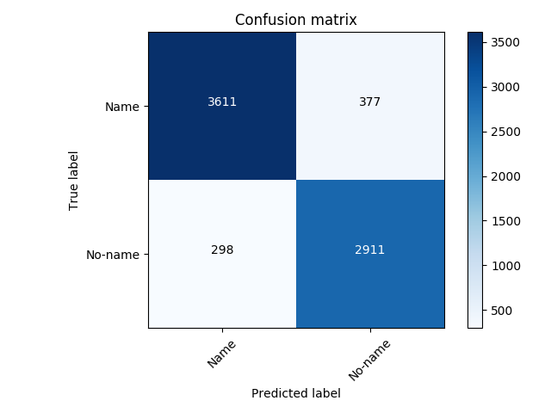
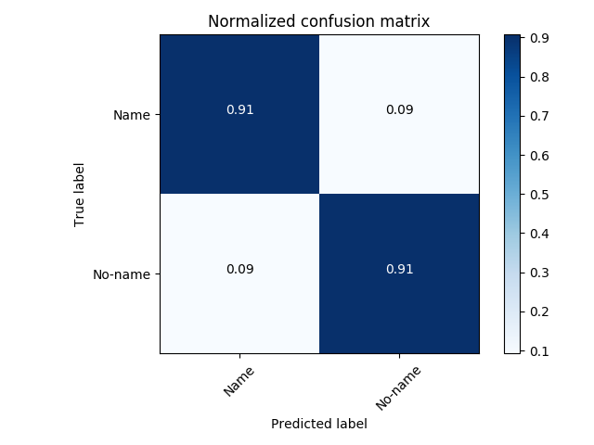
Results SVM-classifier (hold-out set)

